Slide 1
Aspect-Oriented Design Patterns
And Their Use for Advanced Modularization

Slide 2
Autochthonous – Intrinsic Aspect-Oriented Patterns
Cannot be used without aspect-oriented technology (aspect oriented world)
usually require to employ some of various kinds of weaving
Examples:
- Wormhole
- Worker Object Creation
- Cuckoo’s Egg

Slide 3
Task: Run methods in different order according to their first argument after/before certain method is executed
- Delegate such work on worker objects
- Do not modify already provided code

Slide 4
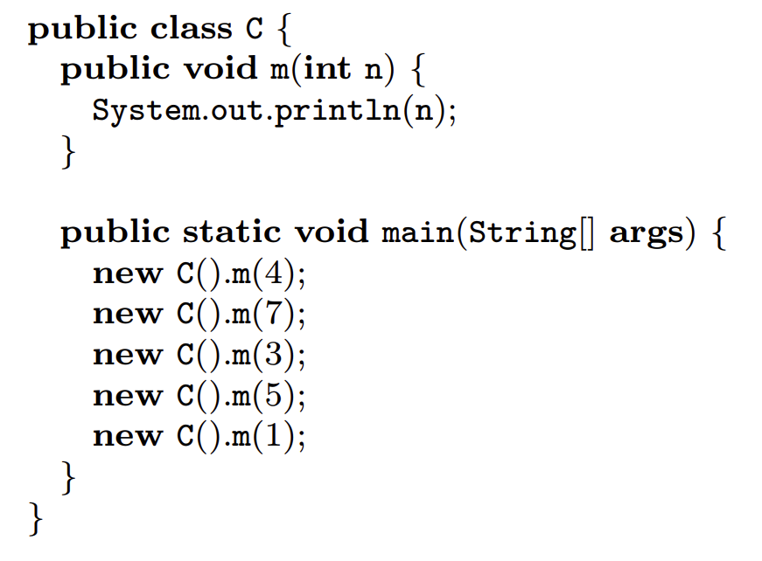
Code that has to be left intact
Source: http://www2.fiit.stuba.sk/~vranic/aosd/poznamky/aspekty-aj.pdf

Slide 5
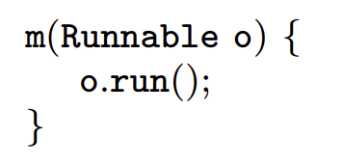
Worker Creation and Its Application
CREATING WORKER
MAKING WORKER WORK
Source: http://www2.fiit.stuba.sk/~vranic/aosd/poznamky/aspekty-aj.pdf

Slide 6
Worker Object Creation
CONTRADICTING FORCES:
1.
A joint point has to be transferred to
another context for execution,
but without transforming corresponding code.
2.
THEIR RESOLUTION:
Using threads with ability to execute particular
method/functionality (proceed() call) after
particular joint point is reached/executed.

Slide 7
Worker Object Creation
void around(): <pointcut> {
Runnable worker = new Runnable() {
public void run() {
// calling inner function body
proceed();
}
};
invoke.Queue.add(worker);
}

Slide 8
Why autochthonous?
void around(): <pointcut> {
Runnable worker = new Runnable() {
public void run() {
// calling inner function body
proceed();
}
};
invoke.Queue.add(worker);
}
Original method is called inside worker
after/before specific joint point
is reached – NO TANGLED CODE!!!

Slide 9
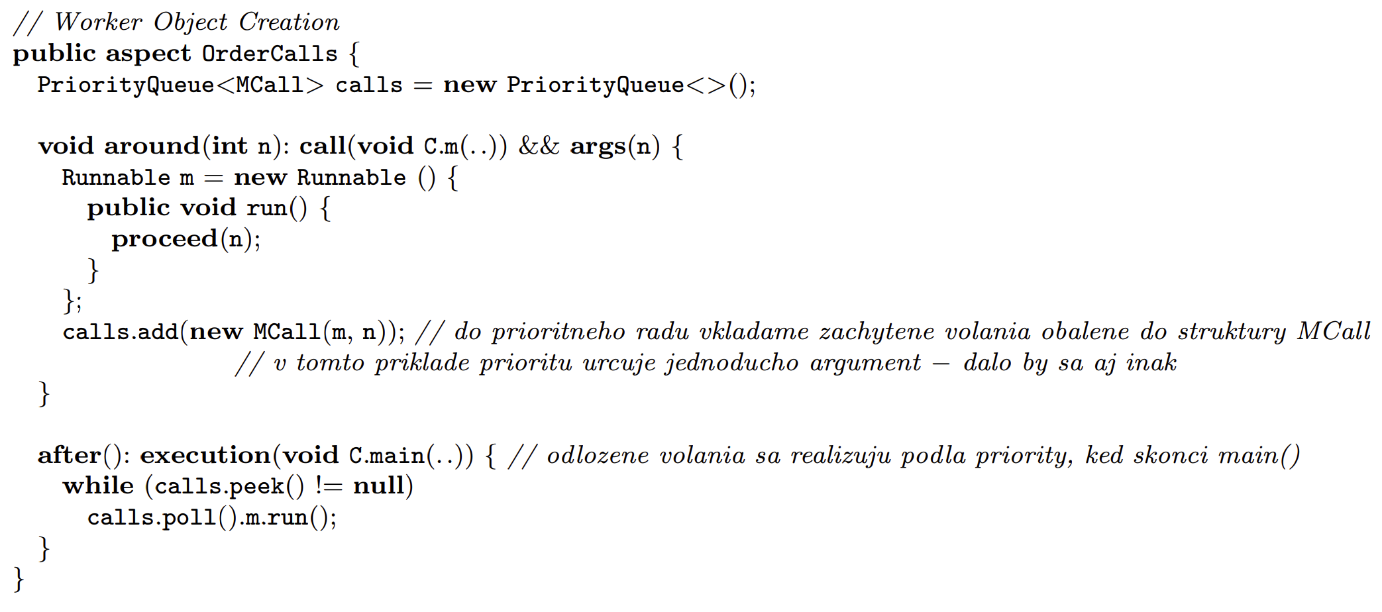
Worker Object Creation
Source: http://www2.fiit.stuba.sk/~vranic/aosd/poznamky/aspekty-aj.pdf

Slide 10
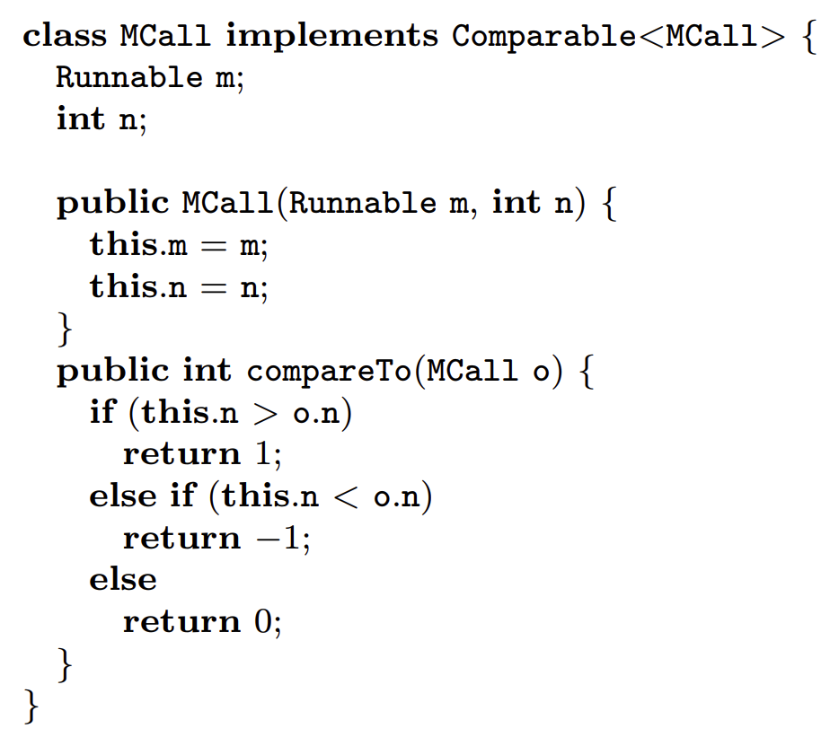
Worker Object Creation
Source: http://www2.fiit.stuba.sk/~vranic/aosd/poznamky/aspekty-aj.pdf

Slide 11
Wormhole
As Wormhole to connect two distinct spaces:
Caller space/concern: <caller context>
Callee space/concern: <callee context>
BENEFIT: without need to extend arguments in place of these spaces – in place of their original methods (implementation of these crosscutting concerns)
Source: https://images.theconversation.com/files/476946/original/file-20220801-62374-uyna4z.jpg?ixlib=
rb-4.1.0&q=45&auto=format&w=1000&fit=clip

Slide 12
Task: Solve or Propagate Tasks To Other Employees But Not Propagate Tasks From Authority With ID = 13

Slide 13
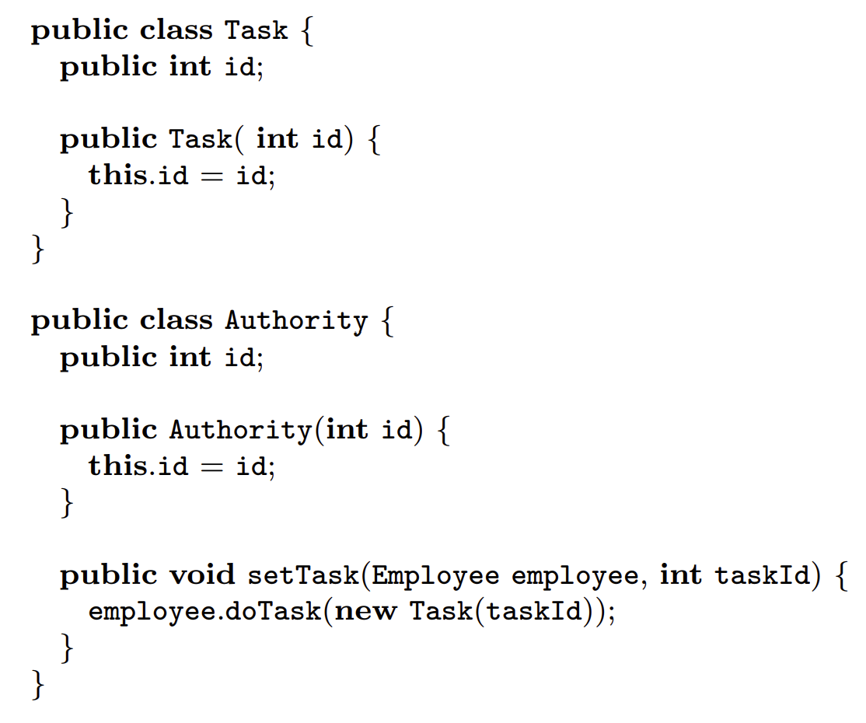
Source: http://www2.fiit.stuba.sk/~vranic/aosd/poznamky/aspekty-aj.pdf

Slide 14
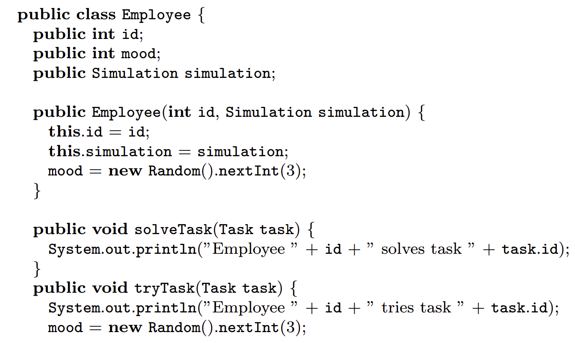
Source: http://www2.fiit.stuba.sk/
~vranic/aosd/poznamky/aspekty-aj.pdf

Slide 15
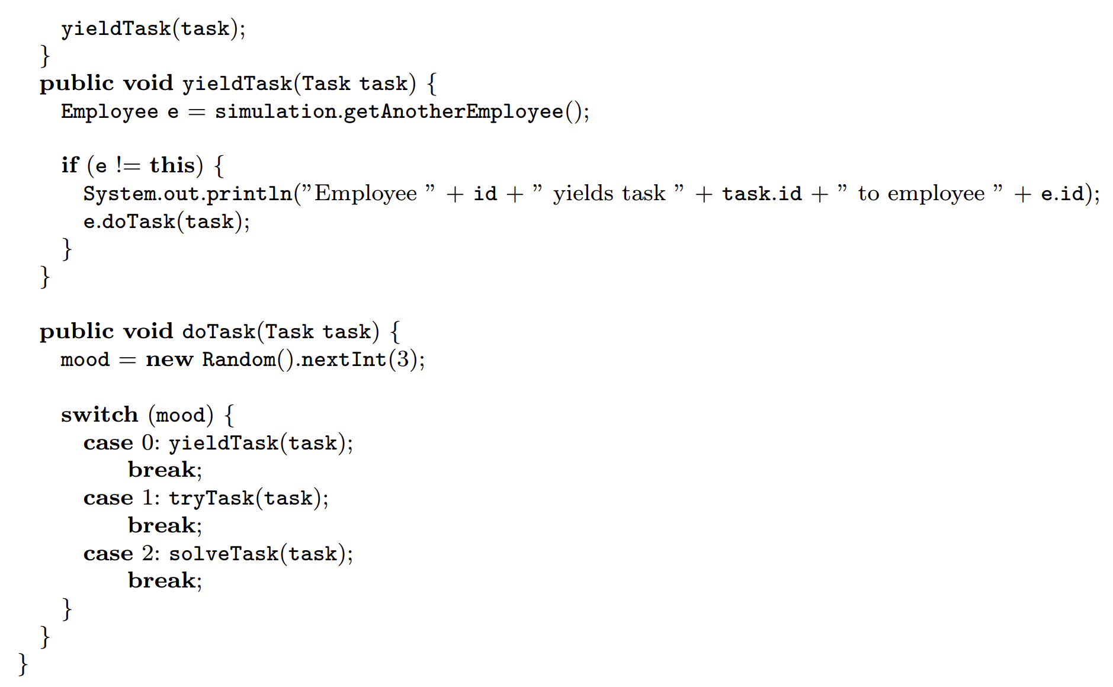
Source: http://www2.fiit.stuba.sk/~vranic/aosd/poznamky/aspekty-aj.pdf

Slide 16
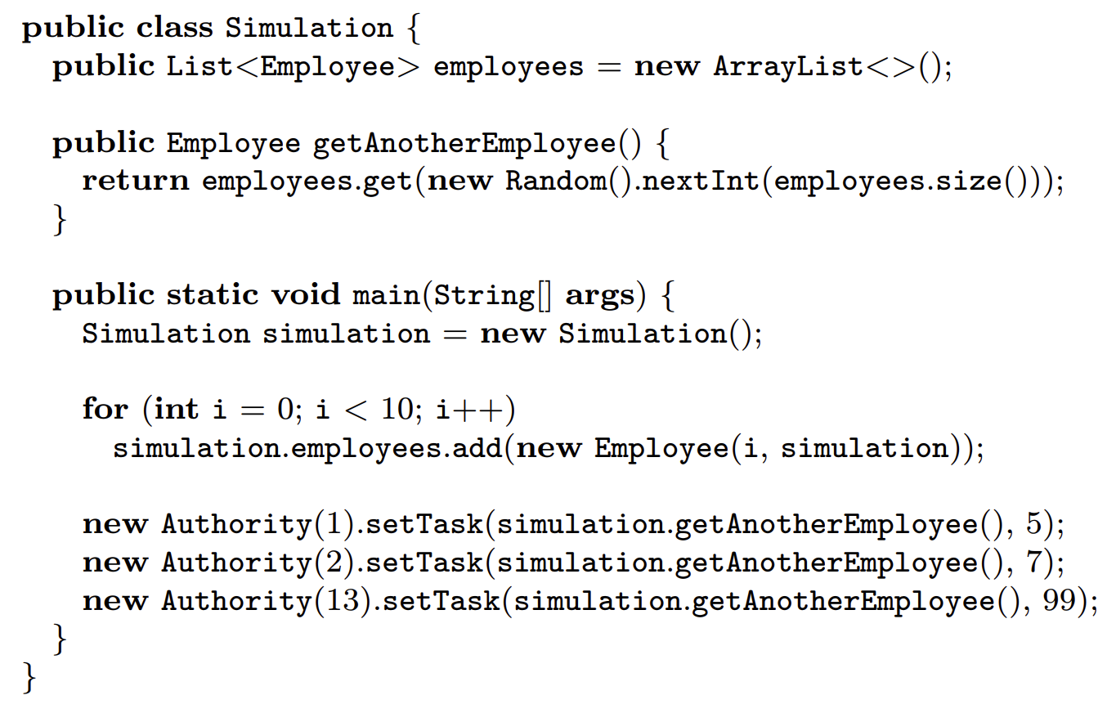
Source: http://www2.fiit.stuba.sk/~vranic/aosd/poznamky/aspekty-aj.pdf

Slide 17
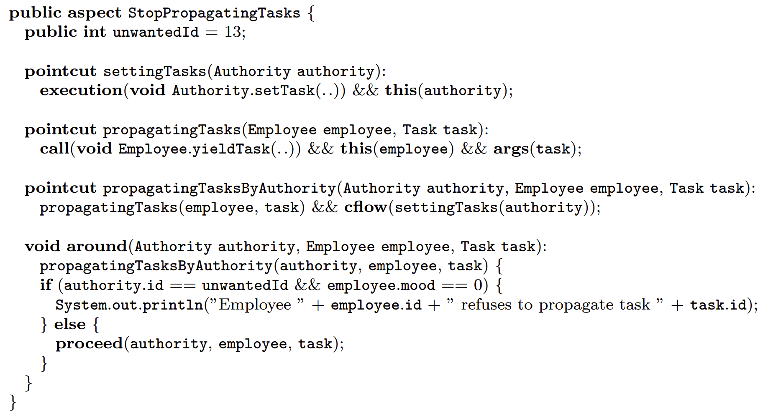

Slide 18
public aspect WormHoleAspect() {
pointcut callerSpace(<caller context>):
<caller pointcut>;
pointcut calleeSpace(<callee context>):
<callee pointcut>;
pointcut wormhole(
<caller context>, <callee context>): cflow(callerSpace(<caller context>))
&& calleeSpace(<callee context>);
Caller space pointcut to capture
particular caller join points
Callee space pointcut to capture
particular callee join points
Specifying situation where new
Concern based on both
concerns should be applied

Slide 19
void around(
<caller context>, <callee context>): c
wormhole(
<caller context>, <callee context>) {
// implementation
// of crosscutting concern
}
}
Here the concern demanding the connection
of two distinct spaces is implemented in
separated aspect – modularized

Slide 20
Wormhole
CONTRADICTING FORCES:
1.
The calling object should be known within
the context of the method being called,
but without transferring it as a parameter.
2.
THEIR RESOLUTION:
Connecting two distinct spaces and resolving
crosscutting concern that requires both of them
in sparated aspect (original code remains unaffected)

Slide 21
Why autochthonous?
Selects callee and caller join
points followed by their
connection to solve
crosscutting concern
using custom advice
public aspect WormHoleAspect() {
pointcut callerSpace(<caller context>):
<caller pointcut>;
pointcut calleeSpace(<callee context>):
<callee pointcut>;
pointcut wormhole(
<caller context>, <callee context>): cflow(callerSpace(<caller context>))
&& calleeSpace(<callee context>);
In object oriented word this
can be treated only using
function arguments and
Possibly tangling concerns

Slide 22
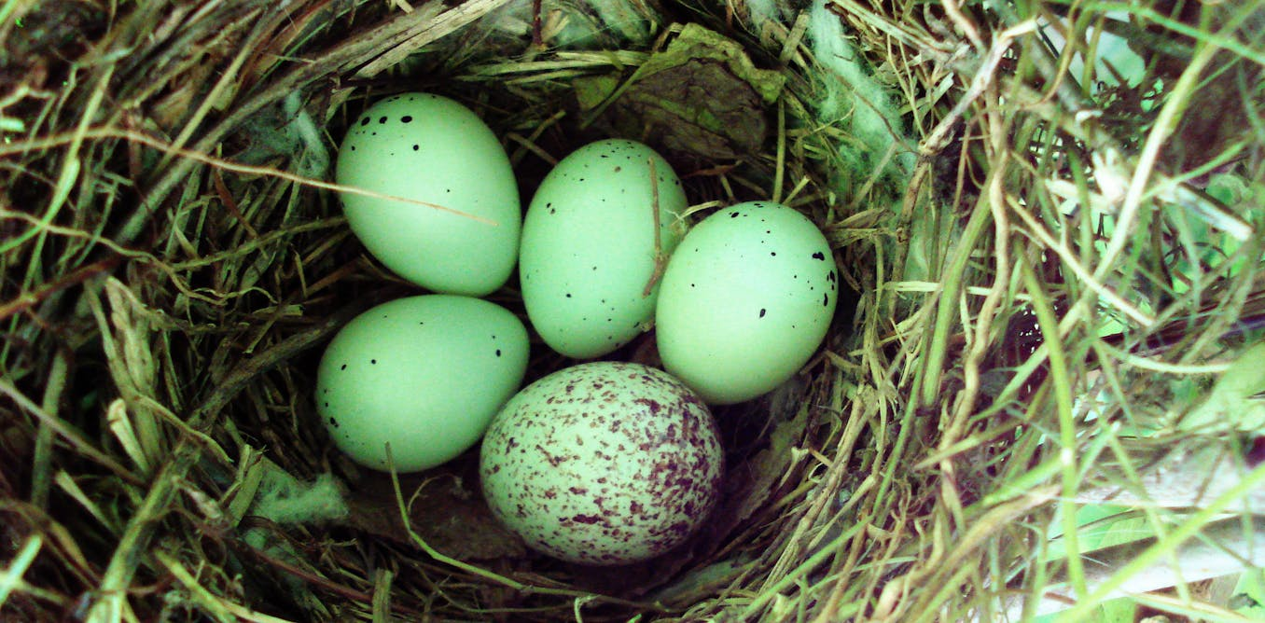
Cuckoo’s Egg
As Egg similar to other eggs in analogy while substituting existing functionality under similar/known type in program:
BENEFIT: existing functionality remained unchanged only new concern is employed as the substitution while instantiating of the
Source: https://www.google.com/url?sa=i&url=https%3A%2F%2Ftheconversation.com%2Fegg-colours-
make-cuckoos-masters-of-disguise-34217&psig=AOvVaw3NA4ZXURt2uxocGpdamS0T&ust=
1724701901436000&source=images&cd=vfe&opi=89978449&ved=0CBIQjRxqFwoTCLCqrrT1kIgDFQAAAAA
dAAAAABAE

Slide 23
public aspect CuckoosEggAspect() {
pointcut cuckoosConstructors():
call(EggClass.new()):
<callee pointcut>;
AbstractEgg around() : cuckoosConstructors() {
return new CuckoosEgg();
}
}
Getting call of
constructor join point
of EggClass (should be
replaced with
CuckoosEgg instance)
Original type
that must hold
Place where replacement with CuckoosEgg
instance will happen

Slide 24
Cuckoo’s Egg
CONTRADICTING FORCES:
1.
Instead of an object of one type, an object of
another type is needed,
but the original type must not be changed.
2.
THEIR RESOLUTION:
Instantianting class of another type inherited from original
type and returning this instance instead of original
created object instance (during its constructor call)

Slide 25
Why autochthonous?
public aspect CuckoosEggAspect() {
pointcut cuckoosConstructors():
call(EggClass.new()):
<callee pointcut>;
AbstractEgg around() : cuckoosConstructors() {
return new CuckoosEgg();
}
}
Constructor
has to be captured
in some way – which is in object
oriented world solved
by changes to original code

Slide 26
Coplien’s form of Cuckoo’s Egg
Problem:
Instead of an object of the original type, under certain conditions,
an object of some other type is needed.
Context:
The original type may be used in various contexts. The need for the object of another type can be determined before the instantiation takes place.
Forces:
An object of some other type is needed, but the type that is going to be instantiated may not be altered.
Solution:
Put the other type instead of the original type before instantiation and provide its instance instead of the original type instance if the conditions for this are fulfilled.
Resulting Context:
The original type remains unchanged, while it appears to give instances of the other type under certain conditions. There may be several such types chosen for instantiation according to the conditions
Rationale:
No need to adapt the original type
Source: http://www2.fiit.stuba.sk/~vranic/aosd/poznamky/aspekty-aj.pdf

Slide 27
Aspect-oriented recreation of object-oriented design patterns
Aspect-oriented recreation of
Gang of Four (GoF)
design patterns
Gang of Four (GoF)
design patterns
Are there any benefits?

Slide 28
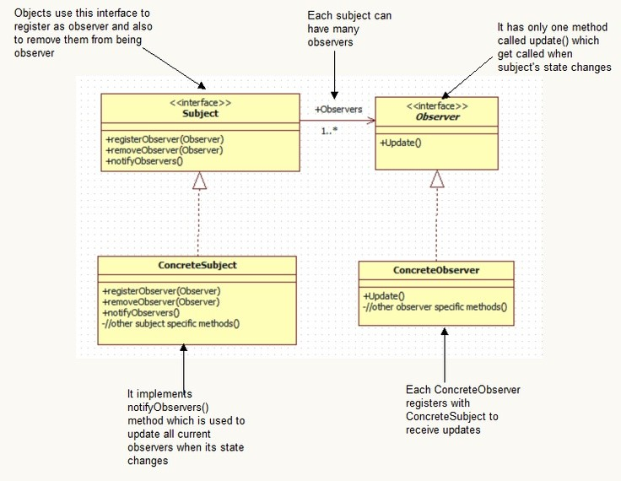
Aspect-oriented recreation
of observer
design
pattern
Observer design pattern
– from GoF
Taken from: https://www.linkedin.com/pulse/observer-pattern-usage-samson-baraka-ipdif

Slide 29
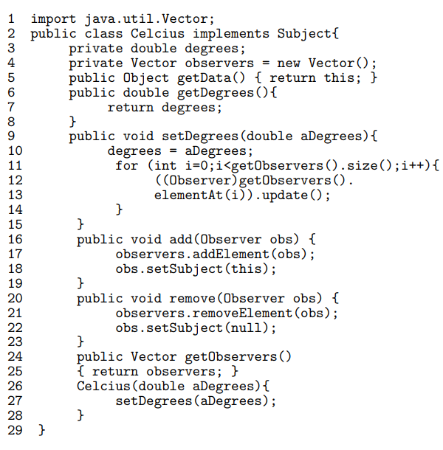
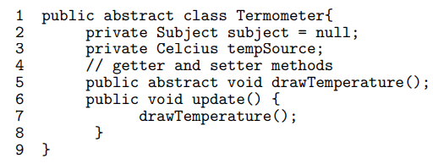
Implementation using pure Java
According to: E. Piveta and L. Zancanella,
“Observer pattern using aspect-oriented programming,
” Proceedings of the Third Latin American Conference
on Pattern Languages of Programming, p. 12, 12 2003

Slide 30
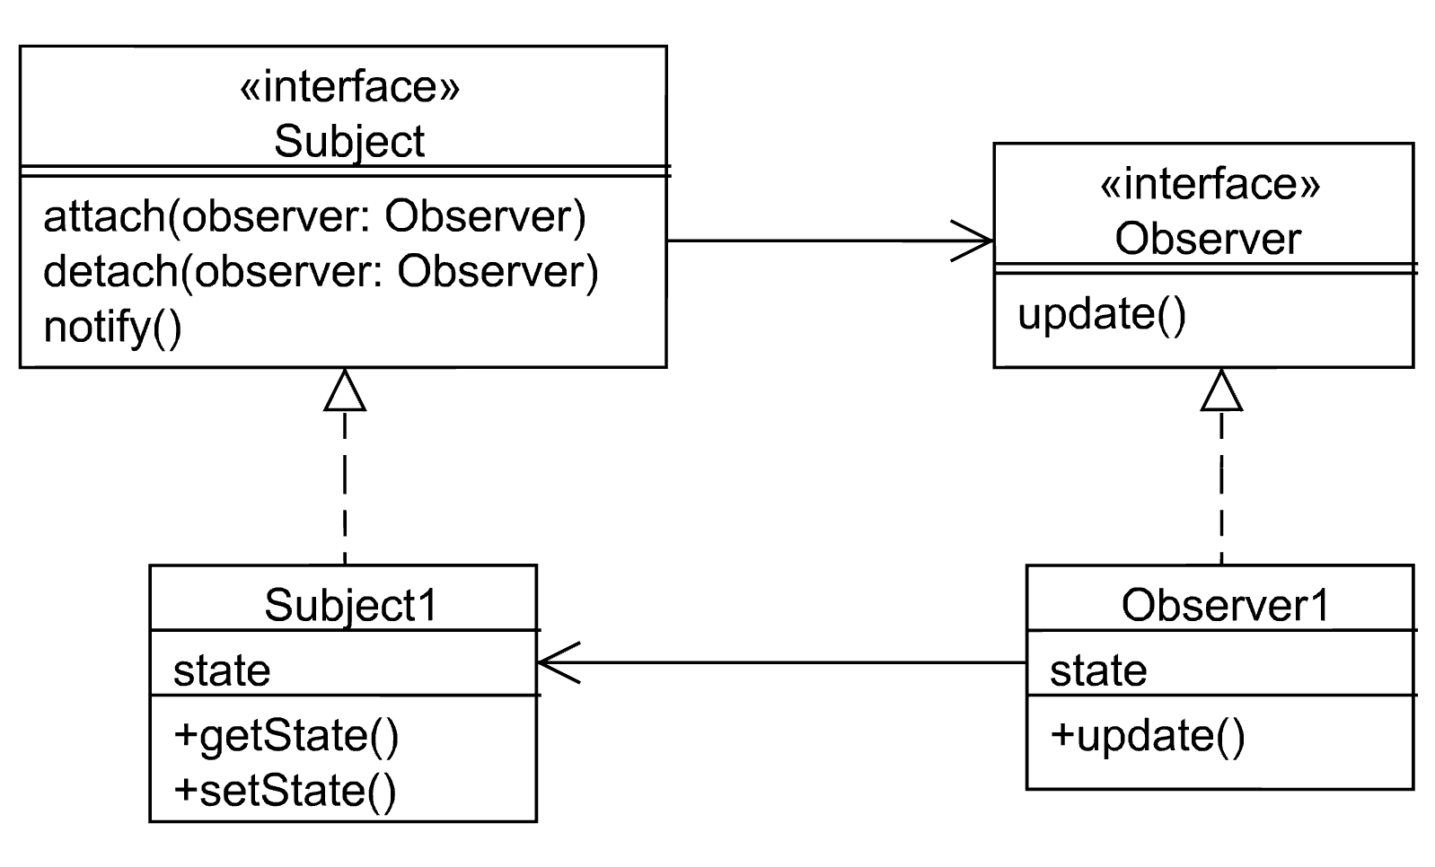
According to: http://www2.fiit.stuba.sk/~vranic/aosd/index.html

Slide 31
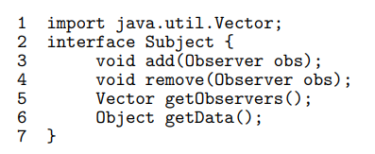
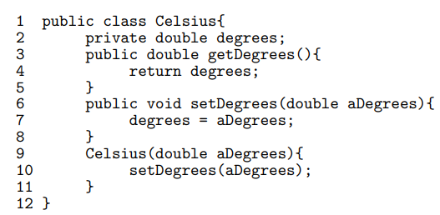
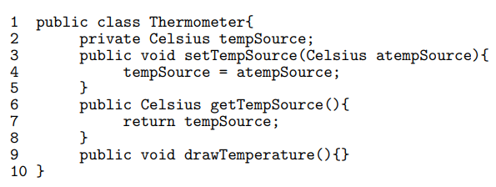
Implementation using AspectJ
Celsius class – the subject
Thermometer class – the observers superclass
Specialized observers

Slide 32
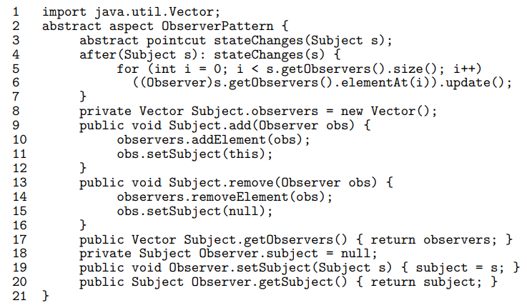
Separating concerns with intertype declaration in AspectJ
Updates observers when
there has been detected
a change
Adds add(Observer obs) method into Subject class
[INTERTYPE DECLARATION]
Adds remove(Observer obs) method into Subject class
[INTERTYPE DECLARATION]
…
[INTERTYPE DECLARATION]
Implementation functionality of observer separated from business logic (measuring temperature)

Slide 33
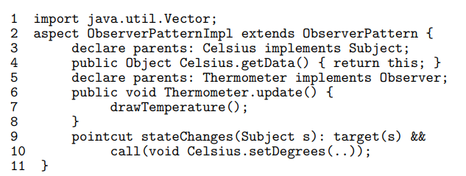
According to: E. Piveta and L. Zancanella,
“Observer pattern using aspect-oriented programming,
” Proceedings of the Third Latin American Conference
on Pattern Languages of Programming, p. 12, 12 2003

Slide 34
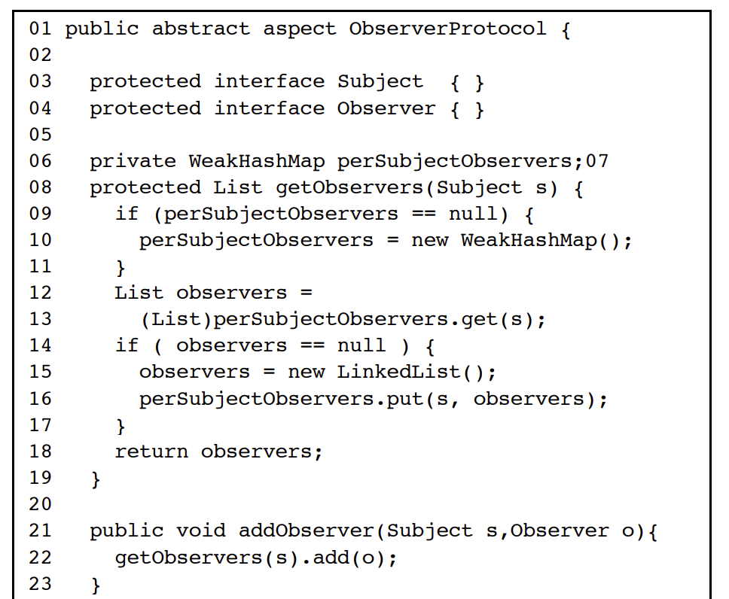
Another Observer Implementation Using Abstract Aspect
Source: J. Hannemann and G. Kiczales,
“Design pattern implementation in Java and AspectJ,” in Proc. of 17th ACM SIGPLAN Conference on Object-Oriented Programming, Systems, Languages, and Applications,
OOPSLA 2002. Seattle, Washington, USA: ACM, 2002, pp. 161–173.

Slide 35
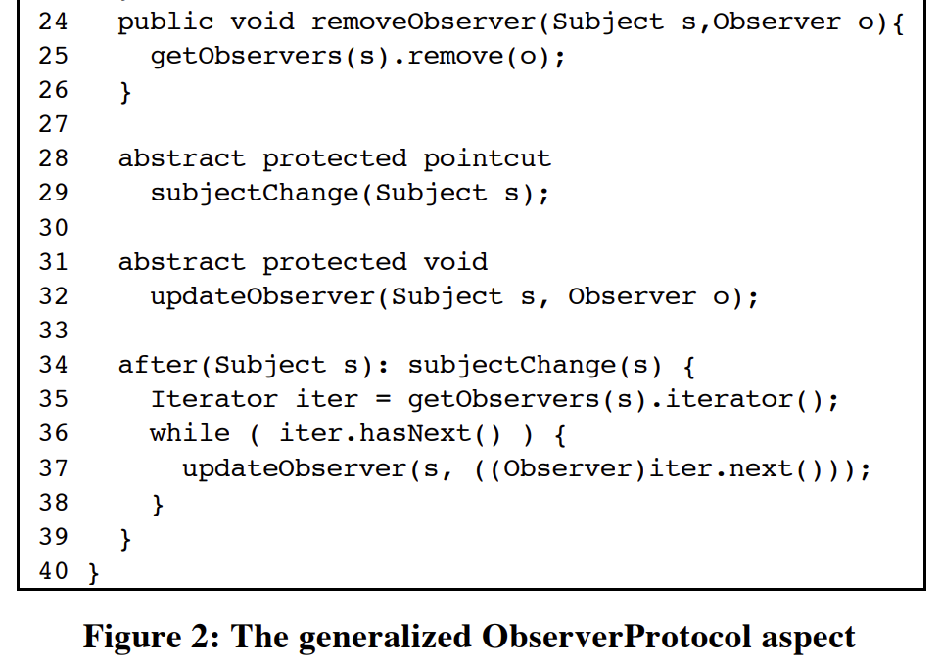
Another Observer Implementation Using Abstract Aspect
Source: J. Hannemann and G. Kiczales,
“Design pattern implementation in Java and AspectJ,” in Proc.
of 17th ACM SIGPLAN Conference on Object-Oriented
Programming, Systems, Languages, and Applications,
OOPSLA 2002. Seattle, Washington, USA: ACM, 2002, pp. 161–173.

Slide 36
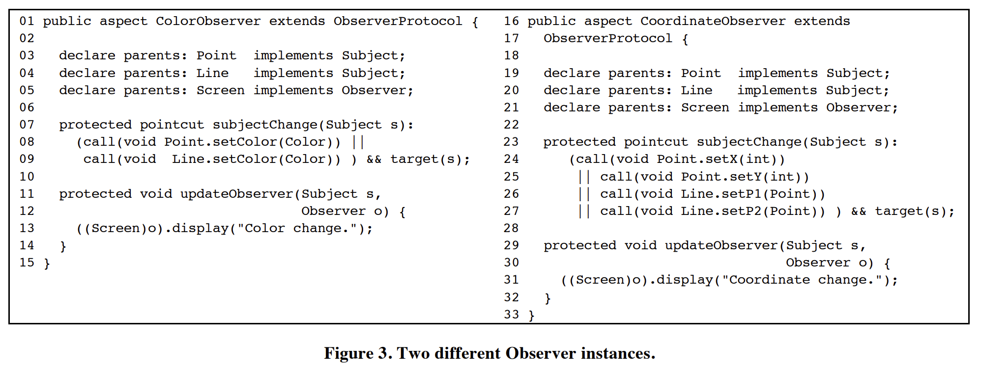
Source: J. Hannemann and G. Kiczales,
“Design pattern implementation in Java and AspectJ,” in Proc. of 17th ACM SIGPLAN Conference on Object-Oriented Programming, Systems, Languages, and Applications,
OOPSLA 2002. Seattle, Washington, USA: ACM, 2002, pp. 161–173.

Slide 37
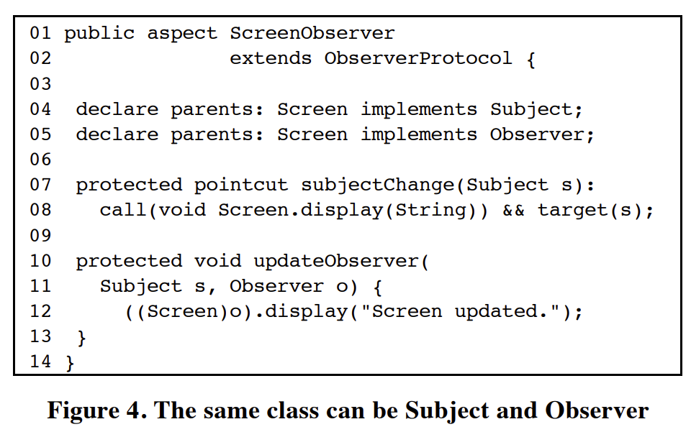
Source: J. Hannemann and G. Kiczales,
“Design pattern implementation in Java and AspectJ,” in Proc. of 17th ACM SIGPLAN Conference on Object-Oriented Programming, Systems, Languages, and Applications,
OOPSLA 2002. Seattle, Washington, USA: ACM, 2002, pp. 161–173.

Slide 38
Intertype declaration
Aspects can declare members (fields, methods, and constructors) that are owned by other types. These are called inter-type members. Aspects can also declare that other types implement new interfaces or extend a new class. Here are examples of some such inter-type declarations:
Source: https://eclipse.dev/aspectj/doc/released/progguide/language-interType.html

Slide 39
Aspect-Oriented Refactoring of Singleton Design Pattern
Creating new and storing
It in HashMap
Catching constructor
call (for Singleton
classes)
Trying to
find instance
in HashMap
A Singleton
instance is returned
Cuckoo´s egg
pattern
Adapted from: P. Baca and V. Vranic, "Replacing Object-Oriented Design Patterns with Intrinsic Aspect-Oriented Design Patterns," 2011 Second Eastern European Regional Conference on the Engineering of Computer Based Systems, Bratislava, Slovakia, 2011, pp. 19-26, doi: 10.1109/ECBS-EERC.2011.13.

Slide 40
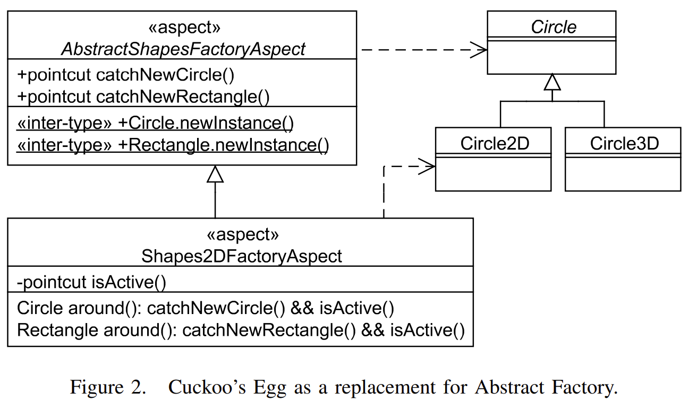
Aspect-Oriented Refactoring of Abstract Factory Design Pattern
Abstract Factory
Aspect-Oriented Recreation of Abstract Factory
-providing interface for creating families
of objects without the specifying the classes
-adding inter-type declarations
to interface to an interface implemented by a factory class
Cuckoo´s egg pattern
Circle2D and Circle3D families of shape classes
Use of and capturing a call to static factory method
FACTORY METHOD to create circle
inserted to abstract Circle class using inter-type declarations
NO CONCRETE FACTORY ASPECT
throwing an exception in this case

Slide 41
Aspect-Oriented Refactoring of State Design Pattern
public aspect StatePattern {
protected MachineState stopped = new StoppedMachineState();
protected MachineState cleaning = new CleaningMachineState();
protected MachineState program1 = new Program1MachineState();
// ALL POSSIBLE STATES OF Machine ENTITY AS PART OF MachineState CLASS
// …………….
after(Machine machine, MachineState machineState): call(void MachineState.stop()) && target(machineState) && this(machine) {
if (machineState.getState() != stopped) {
machineState.setState(stopped);
}
// if machine cannot be stopped from some state then exception should be thrown!
}
Adapted from: R. Miles,
AspectJ cookbook, 1st ed. Sebastopol,
CA; Farnham: O’Reilly Media, 2004.

Slide 42
Aspect-Oriented Refactoring of State Design Pattern
before(Machine machine, MachineState machineState): call(void MachineState.clean()) && target(machineState) && this(machine) {
if (machineState.getState() == stopped) {
raise new Exception(“Stopped machine cannot clean!”);
} else {
System.out.println(“Cleaning has started!”);
machineState.setState(cleaning);
}
}
// OTHER MANAGED STATES WITHIN STATES
// FOR Machine ENTITY/CLASS
// ………….
}
THE STATE AS SEPARATE CONCERN
-not embedded in methods as in OOP
Modularization of rules used in state transition – in one aspect
-easier analysis of state transition – easy to add, modify, and remove the state

Slide 43
Aspect-Oriented Refactoring of Flyweight Design Pattern
ABSTRACTION OF
THE PATTERN
public abstract aspect FlyweightPattern {
private Set<Object> flyweightResources = new HashSet<Object>();
public interface Flyweight {}
protected abstract Flyweight createNewFlyweight(Object object);
protected abstract pointcut flyweightPointcut(Object object);
Object around(Object key): flyweightPointcut(key) && !within(path.this.aspect.FlyweightPattern) {
return this.manageFlyweight(key);
}
Adapted from: R. Miles,
AspectJ cookbook, 1st ed. Sebastopol,
CA; Farnham: O’Reilly Media, 2004.

Slide 44
Aspect-Oriented Refactoring of Flyweight Design Pattern
ABSTRACTION OF
THE PATTERN
public synchronized Flyweight manageFlyweight(Object key) {
if (flyweightResources.containsKey(key)) {
return (Flyweight) flyweightResources.get(key);
} else {
Flyweight flyweigthHeavyWeight = createNewFlyweight(key);
flyweightResources.put(key, flyweigthHeavyWeight);
return flyweigthHeavyWeight;
}
}
}
Adapted from: R. Miles,
AspectJ cookbook, 1st ed. Sebastopol,
CA; Farnham: O’Reilly Media, 2004.

Slide 45
Aspect-Oriented Refactoring of Flyweight Design Pattern
public aspect HeavyWeightObjectLifting extends Flyweight {
declare parents: HeavyWeightObjectLifting implements Flyweight;
protected pointcut flyweightApplication(Integer weight): call(path.heavy.weight.instance.HeavyWeight.new(Integer)) && args(weight);
protected Flyweight applyNewFlyweight(Integer weight) { return new HeavyWeight(weight);
}
}
Adapted from: R. Miles,
AspectJ cookbook, 1st ed. Sebastopol,
CA; Farnham: O’Reilly Media, 2004.

Slide 46
Aspect-Oriented Refactoring of Flyweight Design Pattern
Using Cuckoo´s egg pattern instead
Creating the new instance on every request when such instance is needed
Searching and optionally getting instance from the hash-table if available
Otherwise creating new (heavy weight) instance calling proceed() in aspect method
Storing instance in hash map
Returning instance
Adapted from: P. Baca and V. Vranic, "Replacing Object-Oriented Design Patterns with Intrinsic Aspect-Oriented Design Patterns," 2011 Second Eastern European Regional Conference on the Engineering of Computer Based Systems, Bratislava, Slovakia, 2011, pp. 19-26, doi: 10.1109/ECBS-EERC.2011.13.

Slide 47
Replacing OOP Patterns With AOP Intrinsic Ones
Each is Replaced
With
Singleton
Cuckoo’s Egg
Abstract Factory
Flyweight
Adapted from: P. Baca and V. Vranic, "Replacing Object-Oriented Design Patterns with Intrinsic Aspect-Oriented Design Patterns," 2011 Second Eastern European Regional Conference on the Engineering of Computer Based Systems, Bratislava, Slovakia, 2011, pp. 19-26, doi: 10.1109/ECBS-EERC.2011.13.

Slide 48
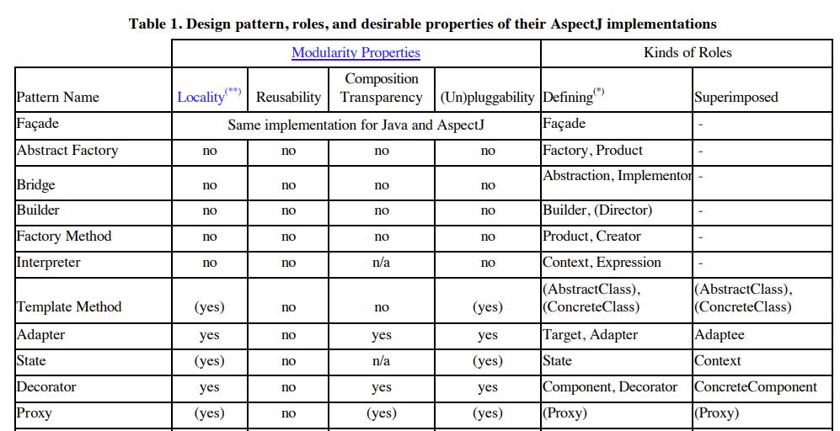
Source: J. Hannemann and G. Kiczales, “Design pattern implementation in Java and AspectJ,” in Proc.
of 17th ACM SIGPLAN Conference on Object-Oriented Programming, Systems, Languages, and Applications,
OOPSLA 2002. Seattle, Washington, USA: ACM, 2002, pp. 161–173.

Slide 49
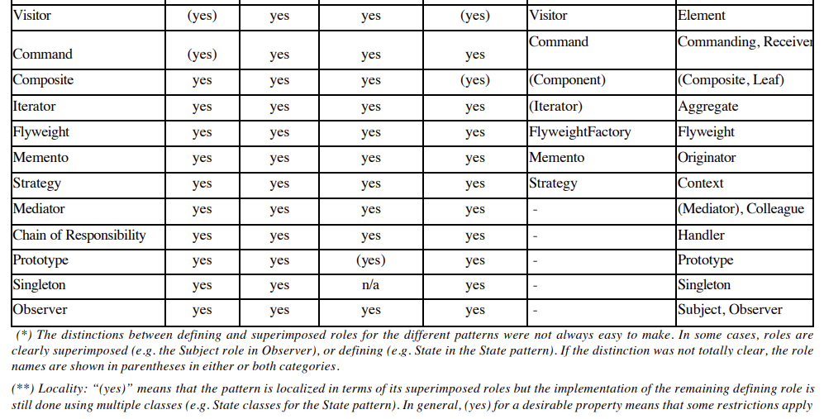
Source: J. Hannemann and G. Kiczales, “Design pattern implementation in Java and AspectJ,” in Proc.
of 17th ACM SIGPLAN Conference on Object-Oriented Programming, Systems, Languages, and Applications,
OOPSLA 2002. Seattle, Washington, USA: ACM, 2002, pp. 161–173.

Slide 50
Aspect-Oriented Recreation of Design Patterns - Benefits
USING ROLES ONLY WITHIN PATTERN ASPECTS
STRUCTURALLY THE SAME
FACADE
– the implementation in AspectJ is the same
-pattern is providing unified interface
-to a set of interfaces of subsystem
COMPOSITE, COMMAND, MEDIATOR, CHAIN OF RESPONSIBILITY
-good namespace management required
-introduced roles as part of only aspect patterns
– not need to expose them to outside world
(such as in OBSERVER pattern)
MODULARIZATION OF SCATTERED CODE
STATE, INTERPRETER
-separation of state management
in State pattern
EMPTY (PROTECTED) INTERFACES
INTRODUCTION OF TYPES
Defining abstraction
(concretized later for
specific application)
-used within pattern
-defined in abstract aspect
-roles
-implementation where possible

Slide 51
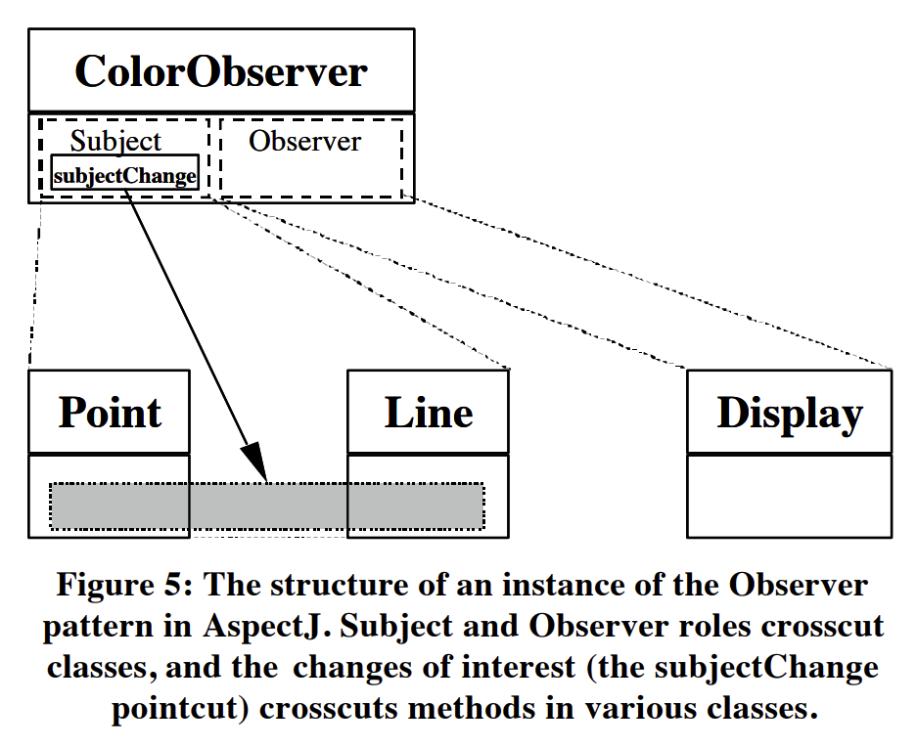
Roles and Their Crosscutting in Patterns
1 role can be represented by many classes and vice-versa
1 conceptual operation can crosscut more methods and vice-versa
Many roles in one class
In pattern language/composition the class from one role
can take other role from different pattern
Conceptual methods where 1 method
crosscuts many classes
Source: J. Hannemann and G. Kiczales, “Design pattern implementation in Java and AspectJ,” in Proc.
of 17th ACM SIGPLAN Conference on Object-Oriented Programming, Systems, Languages, and Applications,
OOPSLA 2002. Seattle, Washington, USA: ACM, 2002, pp. 161–173.

Slide 52
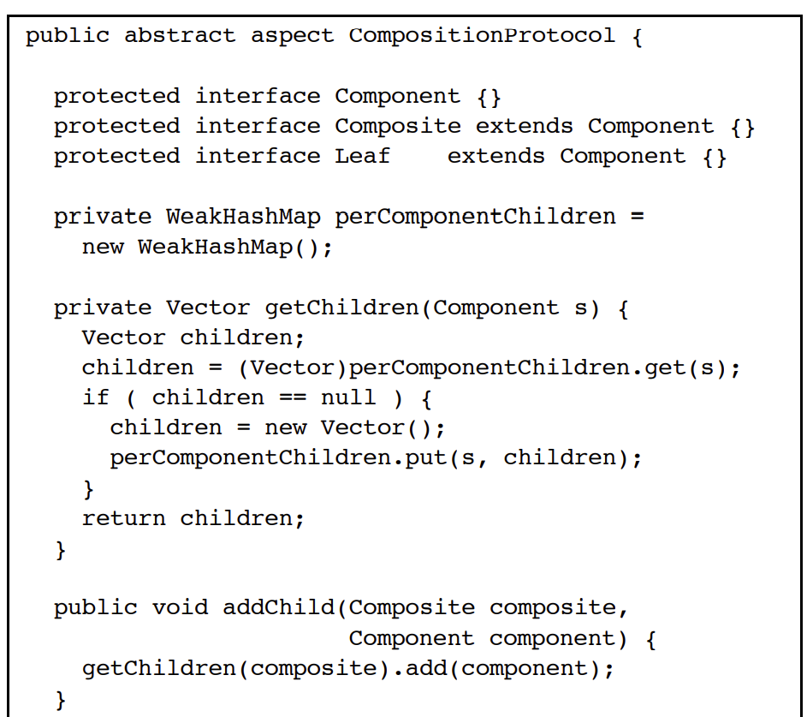
Composite pattern
EMPTY INTERFACES
-->Defining roles in patterns
-introducing types
-[key, value] =
[Composite/Component,
Vector<Component>]
-->Implementing default behavior
according to pattern
Source: J. Hannemann and G. Kiczales, “Design pattern implementation in Java and AspectJ,” in Proc.
of 17th ACM SIGPLAN Conference on Object-Oriented Programming, Systems, Languages, and Applications,
OOPSLA 2002. Seattle, Washington, USA: ACM, 2002, pp. 161–173.

Slide 53
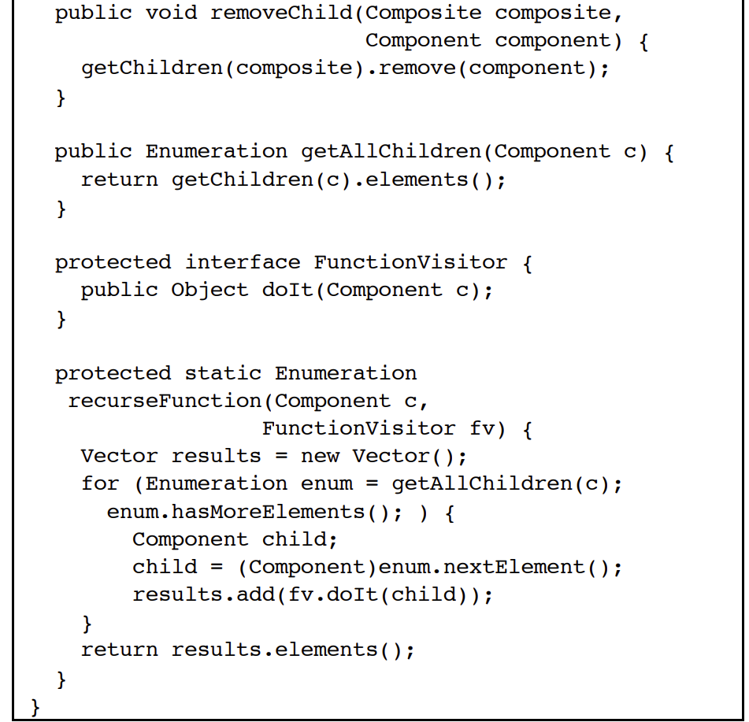
-->Implementing default behavior
according to pattern
Source: J. Hannemann and G. Kiczales, “Design pattern implementation in Java and AspectJ,” in Proc.
of 17th ACM SIGPLAN Conference on Object-Oriented Programming, Systems, Languages, and Applications,
OOPSLA 2002. Seattle, Washington, USA: ACM, 2002, pp. 161–173.

Slide 54
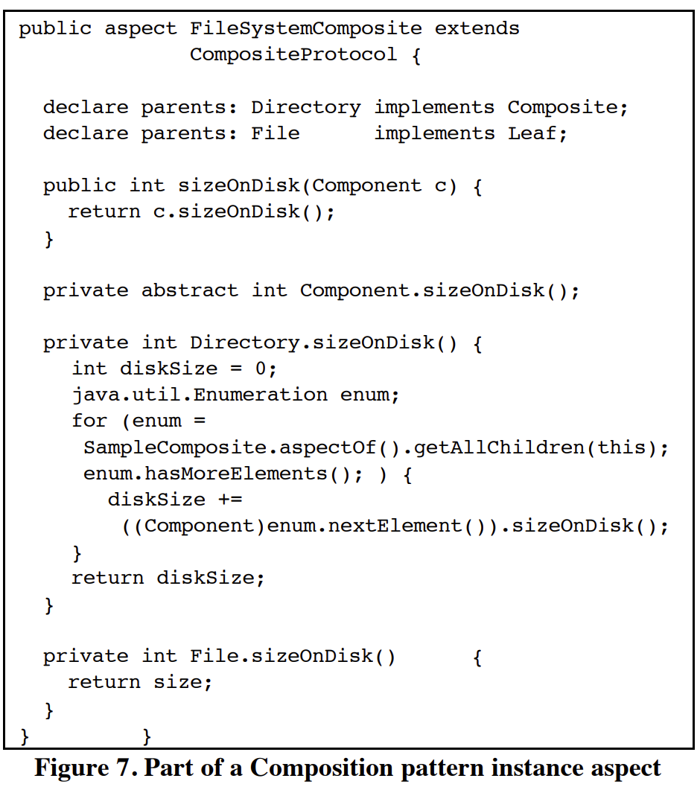
-->Specific Aspect to uniformly
traverse files/directories
-->Applying roles from parent for specific case
- Directory =has role= Composite
- File =has role= Leaf
Client get size on disk using public methods
-others are encapsulated
within pattern (aspect)!!!
-->Specific implementation of
how the size on disk is calculated
-using intertype declaration
Source: J. Hannemann and G. Kiczales, “Design pattern implementation in Java and AspectJ,” in Proc.
of 17th ACM SIGPLAN Conference on Object-Oriented Programming, Systems, Languages, and Applications,
OOPSLA 2002. Seattle, Washington, USA: ACM, 2002, pp. 161–173.

Slide 55
ASPECTS USED AS OBJECT FACTORIES
SINGLETON, PROTOTYPE, MEMENTO, ITERATOR, FLYWEIGHT
-factory methods:
a) PARAMETERIZED METHODS ON ABSTRACT ASPECT
b) METHODS ATTACHED ON PARTICIPANTS
Nordberg’s factory example:
-empty factory method returning null or default object
around advice
Extending factory without modification of original code
- is used to return specific instances of particular types wrapping this factory method
Source: J. Hannemann and G. Kiczales, “Design pattern implementation in Java and AspectJ,” in Proc.
of 17th ACM SIGPLAN Conference on Object-Oriented Programming, Systems, Languages, and Applications,
OOPSLA 2002. Seattle, Washington, USA: ACM, 2002, pp. 161–173.
-new object is instantiated according to provided arguments
-otherwise default or null value is returned calling original method
-removes close coupling between original object and its representants / accessor is removed in Memento, Iterator

Slide 56
Aspect-Oriented Recreation of Design Patterns - Benefits
ALLOWS MUTIPLE INHERITANCE
INTRODUCING NEW LANGUAGE CONSTRUCTS
STRUCTURALLY THE SAME
BRIDGE, BUILDER, FACTORY METHOD, ABSTRACT FACTORY
-aspect implementation fully replaces object-oriented one
PROXY, STRATEGY, DECORATOR
VISITOR, ADAPTER
– replacing abstract classes (from original
implementations) with interfaces
-attaching the advice
Preserving ability to attach implementation
to their default methods
-extending interface of Adaptee
Limited form of multiple inheritance
- Open Class Mechanism
- Attaching fields, methods – extending classes
- Attaching fields, methods – extending classes

Slide 57
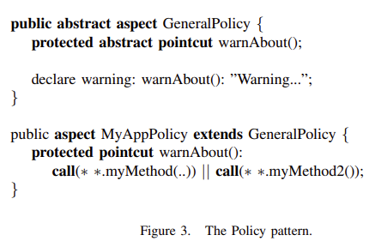
Policy Pattern
Police Enforcement
Defining policies or rules with the application
Compiler warning or error if such policy is broken
IN ONE
ASPECT
IN TWO
ASPECT
-project wide
rules or policies
-local rules or
exceptions
-defining abstraction
using abstract aspect
Source: R. Menkyna, V. Vranić and I. Polášek, "Composition and
categorization of aspect-oriented design patterns," 2010 IEEE 8th
International Symposium on Applied Machine Intelligence and
Informatics (SAMI), Herlany, Slovakia, 2010, pp. 129-134,
doi: 10.1109/SAMI.2010.5423751.
-allows to specify pointcuts
later during development

Slide 58
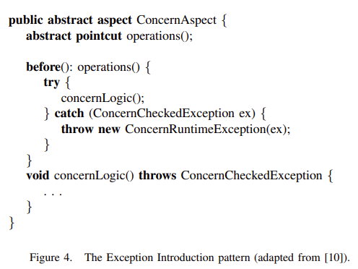
Exception Introduction Pattern
If exception is not handled by advice
Should be handled in higher context
Advice cannot declare throwing a checked exception
-advised join point has to declare this exception
-unlikely BASE CONCERNS TEND TO BE ADAPTED
TO THEIR ASPECTS
(HANDLING CROSSCUTTING CONCERNS)
ESSENCE OF THIS PATTERN
CATCHING A CHECKED EXCEPTION
WRAPPING IT INTO A
NEW CONCERN SPECIFIC RUNTIME EXCEPTION
Source: R. Menkyna, V. Vranić and I. Polášek, "Composition and categorization of aspect-oriented design patterns," 2010 IEEE 8th International Symposium on Applied Machine Intelligence and Informatics (SAMI), Herlany, Slovakia, 2010, pp. 129-134, doi: 10.1109/SAMI.2010.5423751.

Slide 59
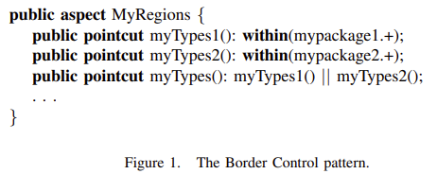
Border Control Pattern
Defining regions in the application
-to restrict processing/modification only to
particular places
In case of changes
Only regions in respective aspect will be redefined/changed
-other dependencies (aspect using it) are automatically
redirected to newly defined places
Single aspect containing only pointcuts
That define boundaries of regions
Using pointcuts (primitives) based on lexical structure
Source: R. Menkyna, V. Vranić and I. Polášek, "Composition and
categorization of aspect-oriented design patterns," 2010 IEEE 8th
International Symposium on Applied Machine Intelligence and
Informatics (SAMI), Herlany, Slovakia, 2010, pp. 129-134,
doi: 10.1109/SAMI.2010.5423751.
within() and withincode()

Slide 60
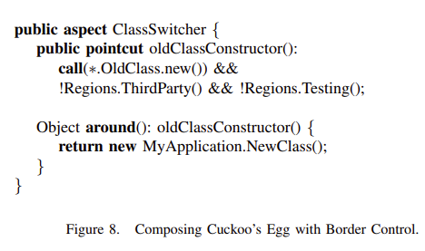
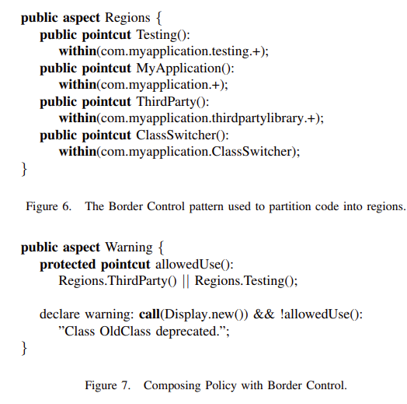
Pattern Compositions
Figure 8 shows how Cuckoo’s Egg may be applied to replace
OldClass constructions with NewClass construction.
Source: R. Menkyna, V. Vranić and I. Polášek, "Composition and categorization of aspect-oriented design patterns," 2010 IEEE 8th International Symposium on Applied Machine Intelligence and Informatics (SAMI), Herlany, Slovakia, 2010, pp. 129-134, doi: 10.1109/SAMI.2010.5423751.

Slide 61
References
Patterns in AspectJ - 8. chapter: The AspectJ in Action Laddad, Ramnivas, 2003. AspectJ in action: practical aspect-oriented programming. Greenwich, CT: Manning. ISBN 978-1-930110-93-9.
Aspect-oriented recreation of Observer design pattern: E. Piveta and L. Zancanella, “Observer pattern using aspect-oriented programming,” Proceedings of the Third Latin American Conference on Pattern Languages of Programming, p. 12, 12 2003
Aspect-oriended recreation of design patterns, application of patterns: R. Miles, AspectJ cookbook, 1st ed. Sebastopol, CA; Farnham: O’Reilly Media, 2004.
HANNEMANN, Jan a Gregor KICZALES, Design Pattern Implementation in Java and AspectJ. 2002, s. 13.
R. Menkyna, V. Vranić and I. Polášek, "Composition and
categorization of aspect-oriented design patterns," 2010 IEEE 8th
International Symposium on Applied Machine Intelligence and
Informatics (SAMI), Herlany, Slovakia, 2010, pp. 129-134,
doi: 10.1109/SAMI.2010.5423751.
P. Baca and V. Vranic, "Replacing Object-Oriented Design Patterns with Intrinsic Aspect-Oriented Design Patterns," 2011 Second Eastern European Regional Conference on the Engineering of Computer Based Systems, Bratislava, Slovakia, 2011, pp. 19-26, doi: 10.1109/ECBS-EERC.2011.13.

Slide 62
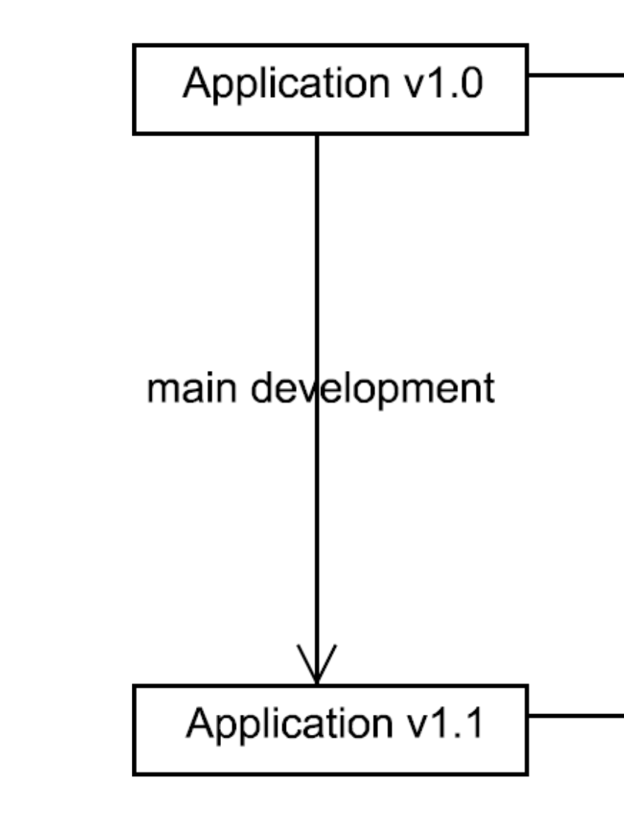
Use of aspects in change realization?
According to: http://www2.fiit.stuba.sk/~vranic/aosd/index.html

Slide 63
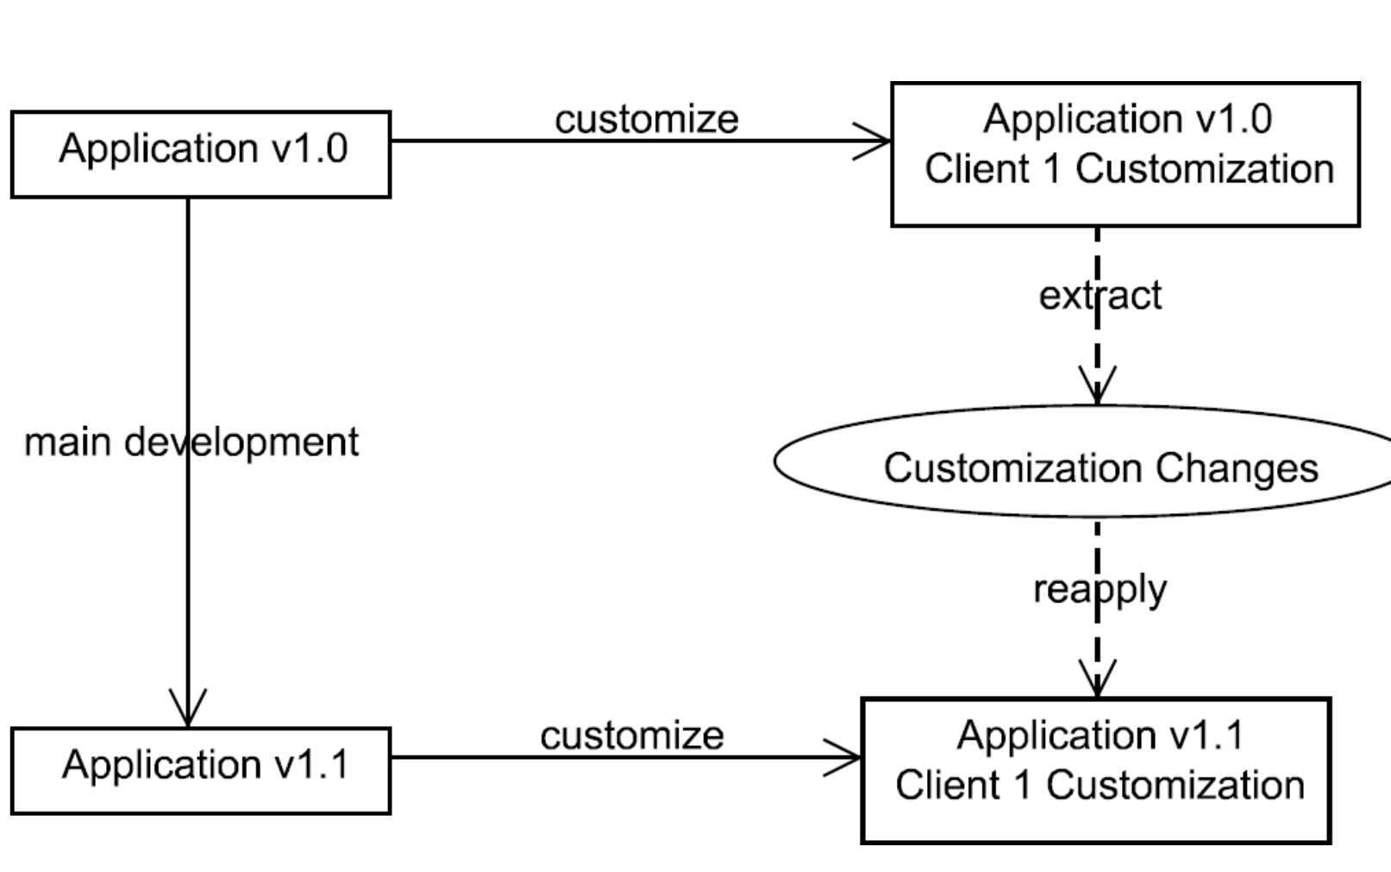
According to: http://www2.fiit.stuba.sk/~vranic/aosd/index.html

Slide 64
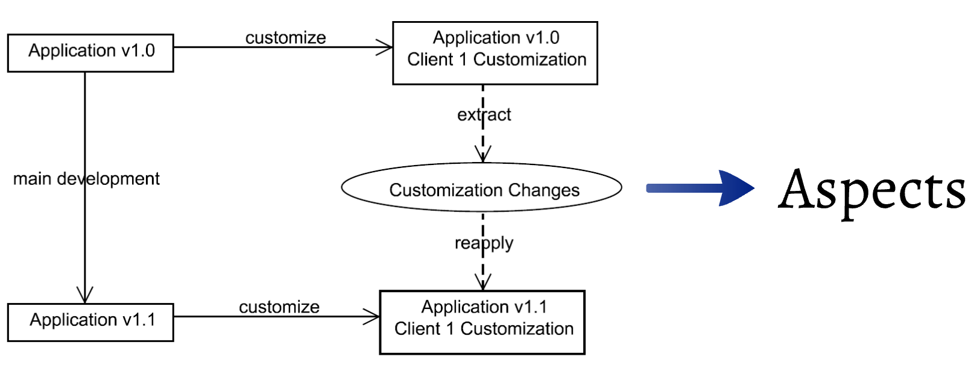
According to: http://www2.fiit.stuba.sk/~vranic/aosd/index.html

Slide 65
According to: http://www2.fiit.stuba.sk/~vranic/aosd/index.html

Slide 66
